Slide 1
Self-Learning Robotic Epitaxy for Superconducting Quantum Circuitry
Yang Group + Interactive Learning Systems Group
MBE Kickoff Meeting, 2025
5/22/2025

Slide 2
“Activizing“ a (Bayesian) deep net?
A Bayesian deep neural network
Samples from posterior BNN
Goal ACC-oriented active learning leads to better label efficiency
w/ Zhang, Khan, Grossman. ICLR 2023

Slide 3
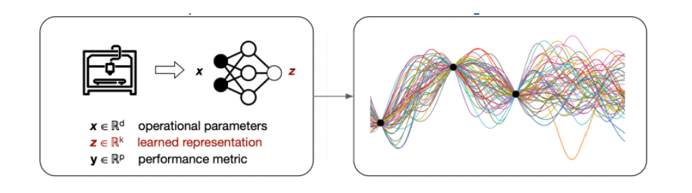
“Activizing” a (deep kernel) Gaussian process?
A deep kernel Gaussian process
Goal Optimization-oriented learning leads to better label efficiency
Identifying the ”regions of interest” for data acquisition
w/ Zhang, Nord, etc. ICML 2023; NeurIPS Workshop on Machine Learning and the Physical Sciences, 2020

Slide 4
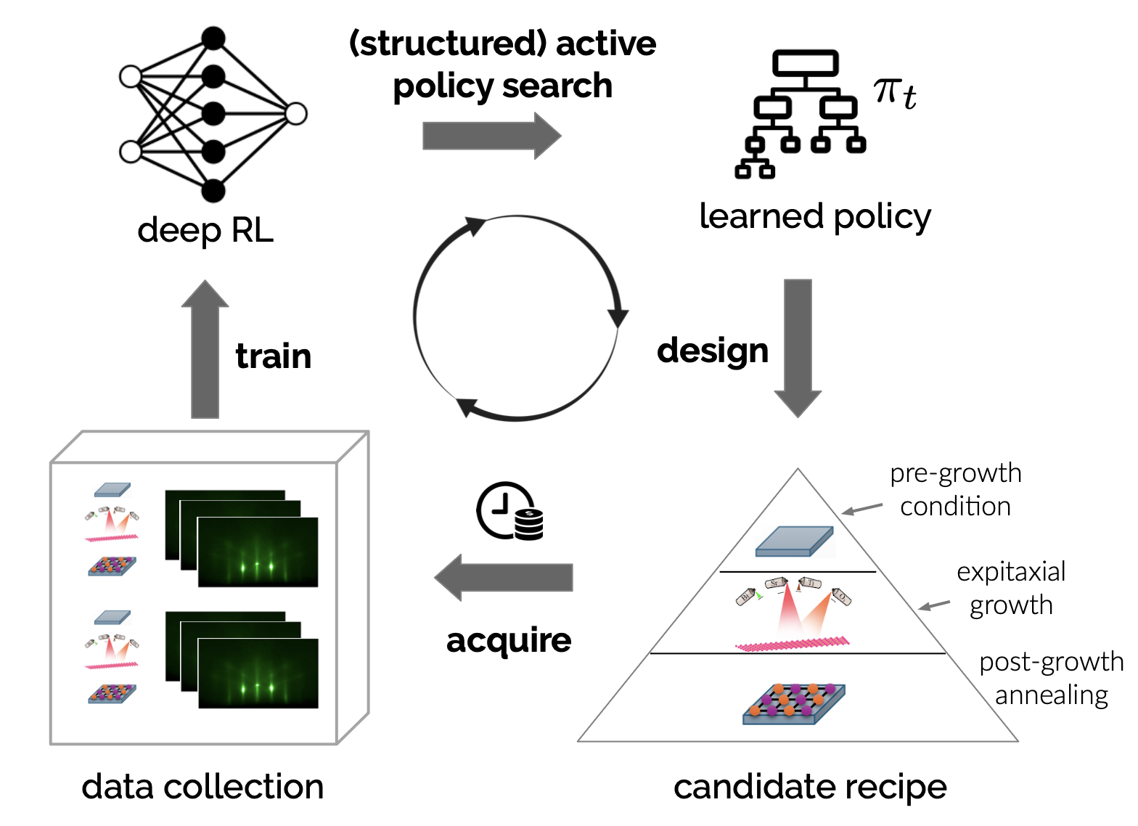
Active learning in reinforcement learning (RL)

Slide 5
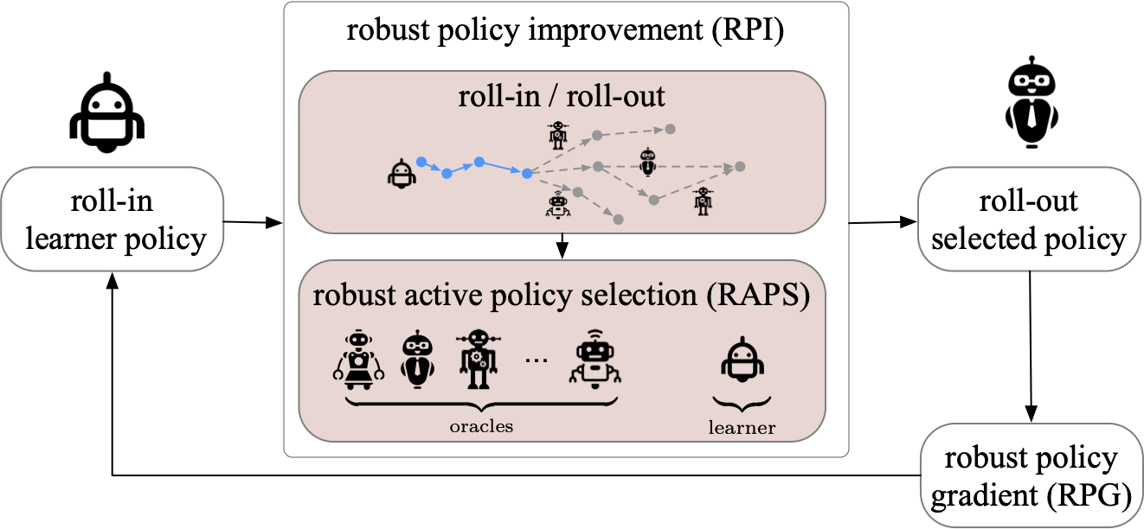
Activizing an RL agent
Actively “exploiting” pre-trained AI models (oracles) achieves better sample efficiency for RL
w/ Liu, Yoneda, Stevens, Walter. ICML 2023, ICLR 2024

Slide 6
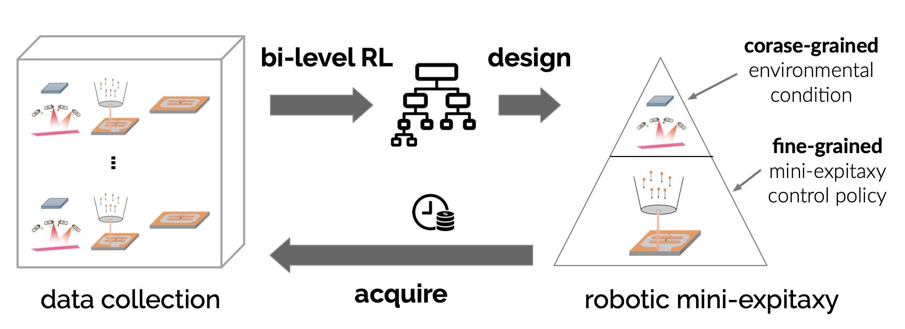
Adaptive recipe design via bilevel deep RL

Slide 7
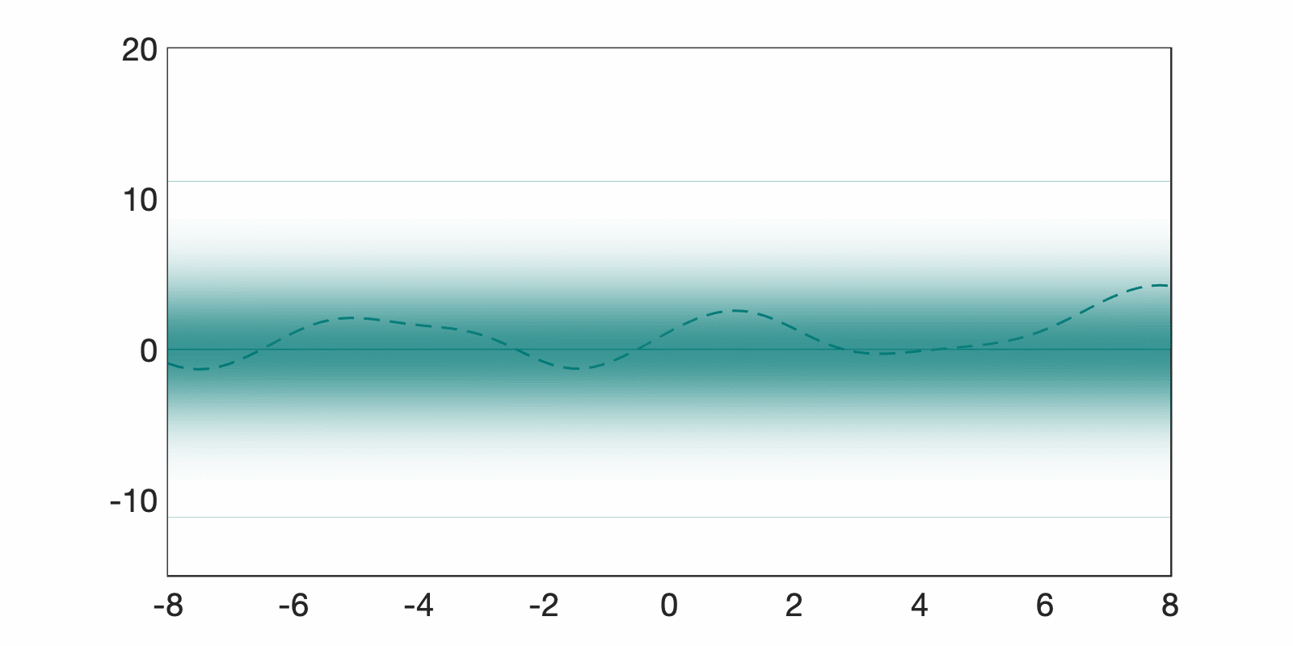

What do we do? basic fundamental tools and building blocks for active learning
“actively” maximizing some target function
“actively” learning some target function
What is the most promising experiment to run?
What are the most useful data points for training my model?

Slide 8
What are the challenges? real-world challenges of automated experimental design
Data is massive
How can we deal with data sets that don’t fit in memory of a single machine?
Models are complex
How can we adapt complexity of classifiers for large data sets?
Environment is dynamic
How can we learn to act in an unknown, dynamic environment (non-i.i.d. data)?
Decisions are high-stake
How can we convey safe decisions in high-stake decision making tasks?
Labels are expensive
How can we obtain most informative labels at minimum cost?
Systems are interactive
How can we optimize the interaction between ML system and other learning agents?
Data is massive
How can we deal with data sets that don’t fit in memory of a single machine?
Models are complex
How can we adapt complexity of classifiers for large data sets?
Environment is dynamic
How can we learn to act in an unknown, dynamic environment (non-i.i.d. data)?
Decisions are high-stake
How can we convey safe decisions in high-stake decision making tasks?
Labels are expensive
How can we obtain most informative/ uncertain/ useful labels at minimum cost?
Systems are interactive
How can we optimize the interaction between ML system and other learning agents?

